Slide 1
Enterprise storage

Slide 2
Introduction
Enterprise storage is a centralized repository for business information that provides common data management, protection and data sharing functions through connections to computer systems.
Because enterprises deal with heavy workloads of business-critical information, enterprise storage systems should be scalable for workloads of hundreds of terabytes or even petabytes without relying on excessive cabling or the creation of subsystems.
Other important aspects of an enterprise storage system are unlimited connectivity and support for multiple platforms.

Slide 3
Benefits of Enterprise storage.
Organizations can choose to purchase and deploy on-premises enterprise storage systems, or they can choose to store their data with an external cloud computing service.
The advantage of on-premises enterprise storage is that the organization retains complete control of the hardware and data, satisfying some security and compliance concerns.
On the other hand, cloud-bases enterprise storage simplifies storage management and may lower costs in some cases.
Some companies take a hybrid approach and use a combination of both on-premise and cloud-based storage.

Slide 4
Types of Enterprise storage
Storage is one of the essential things in IT, and the demands put on enterprise storage systems are constantly increasing. As these demands increase, it’s important to look at all of the available options and understand what advantages or disadvantages each implementation may hold.
In general there are three types of storage an enterprise may consider:
Direct Attached Storage (DAS)
Network Attached Storage (NAS)
Storage Area Network (SAN)

Slide 5
Direct attached storage
Direct Attached Storage is made of a data storage device connected directly to a computer through a host bus adaptor.
Computer Storage that is directly attached to the computer or server, without a storage network.
It can be internally & externally.
It is dedicated to only one server, so cannot be shared between other servers.
It is connected to a LAN / WAN Network.
Examples – Application Server, Print Server, Hard drives, Data Base Server, NFS or CIFS Clients

Slide 6
Network attached storage (Nas)
Network-attached storage (NAS) enables multiple client devices and users to access data from a central pool of disk storage
Users access the shared storage of NAS, which appears as a node with its own Internet Protocol (IP) address on the local area network (LAN) over an Ethernet connection.
Ease of access, low cost and high capacities characterize NAS.
Usually used in places of dedicated file servers

Slide 7
Storage area network (SAN)
SAN was introduced to meet the demands of the storage system, increase the system efficiency & capacity expansion
It transmits data between storage and storage or storage and client servers
It uses a Fiber Channel Fabric Topology
Data from multiple servers is stored is stored in dedicated areas called “Logical Unit Number”
Facilitates direct High Speed Data transfers between servers and storage devices

Slide 8
Network attached storage vs storage area network
Network Attached Storage (NAS) | Storage Area Network (SAN)
Shared storage over shared network. | Shared storage over dedicated network.
Filesystem | Block storage
Easier management | Fast, but expensive

Slide 9
Network file system
Network File System is one of the most commonly used file sharing service
NFS was developed by Sun Microsystems for the Linux environment.
The NFS allows remote hosts to mount filesystems over a network and Interact with those filesystems as though they are mounted locally.
There are 3 versions of NFS: NFSv2, NFSv3, NFSv4.
Server ‘export’ and clients ‘mount’ the export.

Slide 10
Common Internet file system (CIFS)
CIFS is a version of server message block protocol.
CIFS was developed by Microsoft foe windows based clients.
Won’t work in Linux for file sharing.
Server ‘share’ and clients ‘use’ or ‘map’ the share.

Slide 11
Cloud storage
Enterprise cloud storage consists of storage capacity purchased from a public cloud service provider.
Enterprises often turn to cloud storage to reduce or eliminate excessive on-premises storage costs, reduce the complexity of managing storage and upgrade data center infrastructure.
The three major public cloud storage providers are Amazon Web Services (AWS), Google Cloud and Microsoft Azure. Others include Alibaba Cloud, IBM's Bluemix, Oracle and Rackspace, as well as a host of regional providers.

Slide 12
Software defined storage
Software-defined storage (SDS) is a term for computer data storage technologies which separate storage hardware from the software that manages the storage infrastructure.
The software enabling a software-defined storage environment provides policy management for feature options such as deduplication, replication, thin provisioning, snapshots and backup.

Slide 13
Hyper convergence
Hyperconvergence is an IT framework that combines storage, computing and networking into a single system in an effort to reduce data center complexity and increase scalability.
Hyperconverged platforms include a hypervisor for virtualized computing, software-defined storage, and virtualized networking, and they typically run on standard, off-the-shelf servers.
Multiple nodes can be clustered together to create pools of shared compute and storage resources, designed for convenient consumption.

Slide 14
Some Important storage concepts
Deduplication eliminates redundant (duplicate) blocks in a volume. By saving only one instance of a block , disk space can be significantly reduced.
For example the same 10 MB spread sheet is stored in 10 folders for each department. That’s 100 MB of disk space is consumed to maintain the same 10 MB file.
Compression attempts to reduce the size of a file by removing redundant data within the file.
By making files smaller, less disk space is consumed, and more files can be stored on disk.

Slide 15
Throughput - Data transfer speed in megabytes per second is often termed as throughput. Earlier, it was measured in Kilobytes. But now the standard has become megabytes.
Input/output Operations Per Second (IOPS) - The time taken for a storage system to perform an Input/output operation per second from start to finish constitutes IOPS.

Slide 16
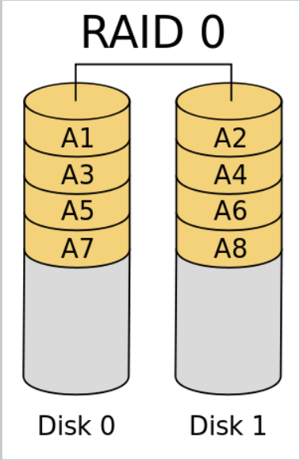
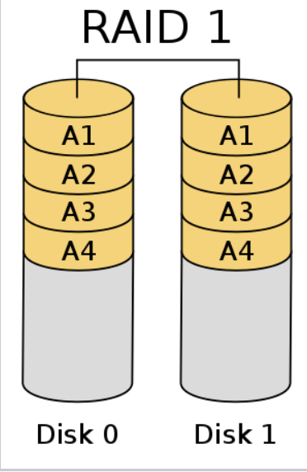
RAID
Redundant array of Independent disks (RAID):
Commonly used RAID levels are 0,1,5,6,10.

Slide 17
